Slide 1
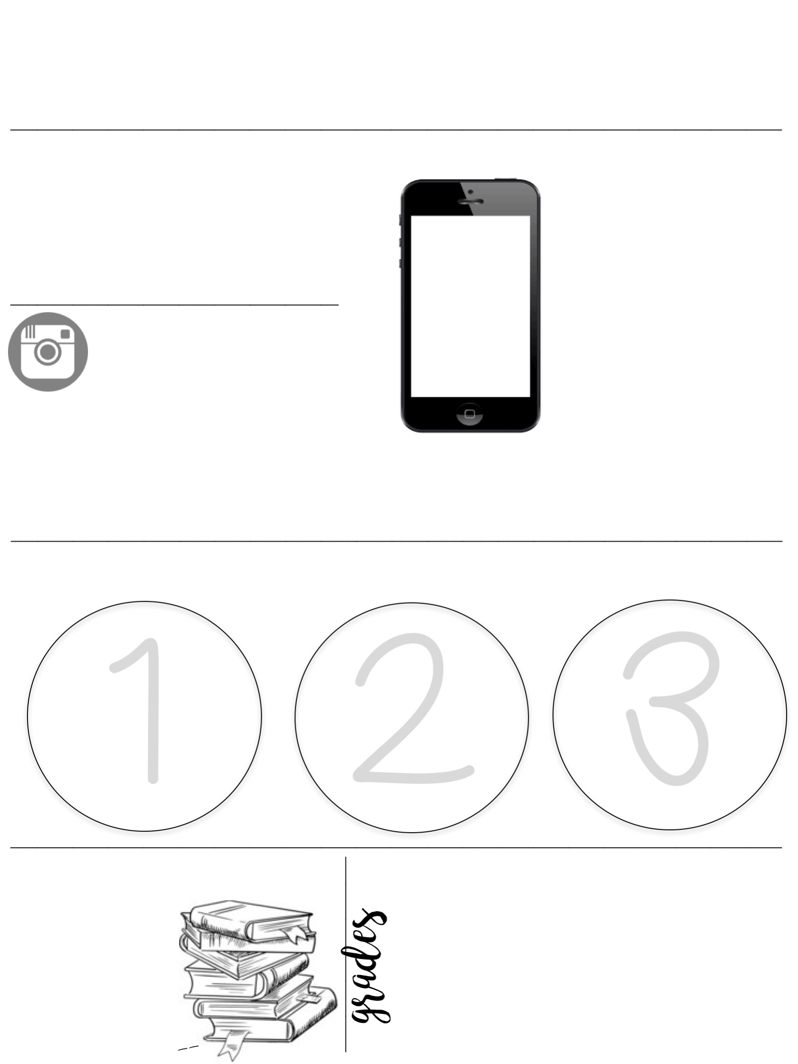
Family Consumer Science
2018 -----
----- 2019
Mrs. Rich
communication with the teacher
1 krich@cisd.org
2 (903) 874-8211 ext. 6369
FCCLA
Text @77k64b to 81010
TEXT
MESSAGE ALERTS
instagram
@mrsrichsclass
Follow our class account to see yourself and classmates in action.
Sign up for the FCCLA text alerts for updates on meetings, service events, and other news. Download the Remind App to be able to talk to Mrs. Rich for help.
_______________________________________________________________________________________
responsibility and preparation
Come
prepared to
class with your folder, planner, notebooks, writing utensils, & interactive notebook supplies.
Be opened minded:
Open kindness!
Open respect!
Open creativity!
Work should
be turned in on its due date.
Late work will result in an incomplete.
_______________________________________________________________________________________
Class Materials
50%
50%
=100%
1 folder with brads
____
Pencils & pens
________
Tests & Projects
________
Daily Grades
Total= 100%
Markers, glue, colored pencils
sticky notes, highlighters

Slide 2
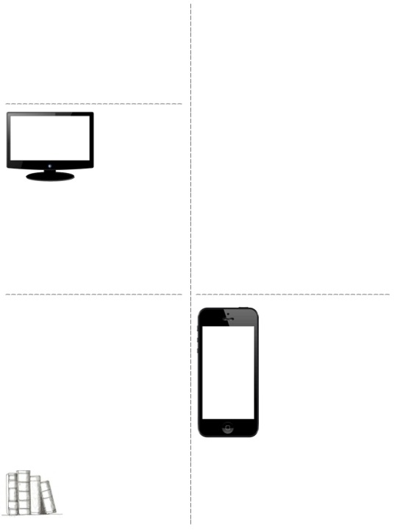
Classroom Rules
Classroom Procedures
Rules…
Be Respectful
Electronics should be put away, unless told otherwise
Classroom is a no charging Zone!
No cussing
No more than FIVE people at a table
Keep your hands to yourself…this includes others property
Procedures…
Entering the classroom
Quietly before the tardy bell
Be seated and ready to go
Charging/phones
Phones should be away for lecture
No charging in the classroom
Absences
You are responsible for making up any missed work
Missed work is due 2 days after the absence
Grooming
ABSOLUTLY no grooming allowed in the classroom (hair, makeup)
ABSOLUTLY no spraying perfume in the classroom
Restroom/leaving the classroom
Only one person out at a time after the 1st 15 minutes of class
Take the pass
Dismissal
A. No one will line up at the door
Projects and assignments
All projects and assignments will be competed in class. You will have SEVERAL days to complete a project. There should be no reason that you do not finish a project.
I do not give homework. All assignments should be completed at the end of the period and turned into their designated box. Folders will stay in the room in their designated box.
Food and Drink Policy
electronic devices
In general, food and drinks are allowed in my class. This is contingent on it not becoming a distraction in class.
During lunch: there will not no one allowed to eat in the classroom. You must go to the commons.
There will not be any fast food or outside food allowed in the classroom after lunch. You should have everything finished before coming back to class. If you come into class with food, I will ask you to throw it away.
Electronic devices are allowed in the class, as long as, they are not a distraction. When there is lecture, you will be expected to put them away.
Mrs. Rich’s classroom is a no charging zone.
Meaning: there is absolutely no charging in C102.
If I see your charger/catch you. I will confiscate both phone and charger till the end of the period.
If it persists there will be phone calls home/referrals

